Slide 1
Dashboard Data Variables for Statistical Analysis

Slide 2
After the MCP work to produce a PB data set and an Infra data set, we will need to focus on the data analyses portion of this project . . .

Slide 3
The top line indicators from the raw data that were used last year follow—ignore column designations from an old excel spreadsheet.
The students later arranged the raw data with all text columns together, then all budget columns together and all schedule columns together.
We will need to discuss, but this will give you an idea

Slide 4
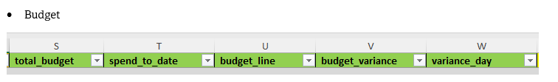
Variance_day seems to go in Schedule, not here
We discovered an existing indicator that calculates the “spend to date %” so that should go in (instead of creating a new variable Spend to Date (T)/Total Budget(S))

Slide 5
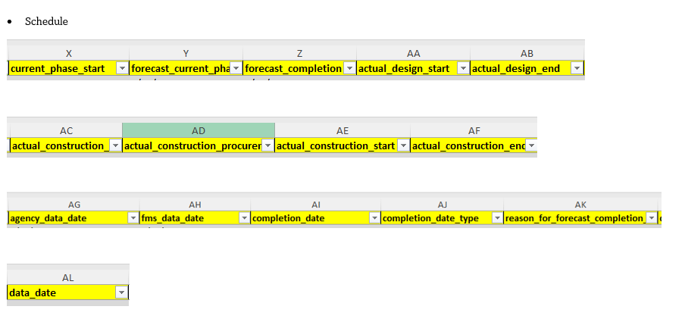
The students added the data in the Reasons for Delay column
See variance_day (W) from prior slide; seems to go with this set
The indicators under AG, AH and AL may not seem necessary for this

Slide 6
Variables and Created Variables from Dashboard Variables from Last Year’s Common Deck

Slide 7
Data Description
The dataset contains detailed information on NYC capital projects, including financial, timeline, and categorization fields. Key components include:
Agency & Organizational Fields | Sponsor Agency – Common acronym of the city agency that the capital project is being managed on behalf of. managing_agency – Common acronym of the city agency that is responsible for managing the construction and delivery of the capital project
Financial Fields | total_budget – The total cost of the project, as reflected by "Commitments" in the City's Financial Management System (FMS) spend_to_date – The amount of money spent to date, as reflected by "Liquidations" in the City's Financial Management System (FMS) budget_variance – This is the difference calculated by 'total budget of current row ' value subtracted by the same column of prior nearest Year-Month reported. variance_day – This is the difference calculated by 'completion date' of current row value subtracted by the same column of prior nearest reporting period.
11

Slide 8
Data Description
The dataset contains detailed information on NYC capital projects, including financial, timeline, and categorization fields. Key components include:
Phase & Timeline Fields | current_phase – The phase the project is in: Pre-Design, Design, Construction Procurement, Construction, or Close-out current_phase_start – Date when the current phase began. forecast_current_phase_end – Projected end date of the current phase. actual_design_start / actual_design_end – Actual timeline for design phase. actual_construction_start / actual_construction_end – Actual timeline for construction phase. forecast_completion – Expected final completion date for the entire project. completion_date – Recorded completion (if finished).
12

Slide 9
Data Description
The dataset contains detailed information on NYC capital projects, including financial, timeline, and categorization fields. Key components include:
Phase & Timeline Fields | current_phase – Current active phase (Pre-Design, Design, Procurement, Construction, Closeout). current_phase_start – Date when the current phase began. forecast_current_phase_end – Projected end date of the current phase. actual_design_start / actual_design_end – Actual timeline for design phase. actual_construction_start / actual_construction_end – Actual timeline for construction phase. forecast_completion – Expected final completion date for the entire project. completion_date – Recorded completion (if finished).
13

Slide 10
From Last Year’s Memo to Students
Suggested created variables from last year, working with the Actuals on the schedule side:
  With Actual design start and Actual design end, you can create a variable for the Design Phase Duration; which can then be further analyzed for percentage change between periods and average percentage change, with the average percentage change becoming a new variable: Design Phase Duration Average Percentage Change.
  With Actual construction procurement start and Actual construction procurement end, you can create a variable for the Construction Procurement Phase Duration, which can then be further analyzed for percentage change between periods and average percentage change, with with the average percentage change becoming a new variable: Construction Procurement Phase Duration Average Percentage Change
  With Actual construction start and Actual construction end, you can create a variable for the Construction Phase Duration; which can then be further analyzed for percentage change and average percentage change, with the average percentage change becoming a new variable: Construction Phase Duration Average Percentage Change.
  To create a variable approximating Total Project Duration, with Forecast Completion date and Actual design start—the only indicator in the data set that shows the beginning of a project, Actual design start –Forecast Completion date becomes the Total Project Duration variable. As above, this variable can then be further analyzed for percentage change and average percentage change, with the average percentage change becoming a new variable: Total Project Duration Average Percentage Change.
Other: each reason for delay should be treated as variables for regression and other analyses.

Slide 11
More . . .
Will’s suggestions last year:
Average schedule delay (days) between period-to-period by sponsor agency
Average budget change (dollars and percentage) between period-to-period and year-to-year by sponsor agency
Since our dataset has many completed projects. Most of the completed projects has full set of actual milestone dates from design start to construction end. What about an analysis over actual phases duration (days) vs actual spent ($)? This might get a correlation between money spent and construction duration (does spending more money always takes longer)? This can also be made a heat map with actual spend on x-axis and construction duration (or total duration) on y-axis, by PB/Infra or agencies.

Slide 12
Still more . . .
Descriptive statistics
For schedule delays and budget increases
Correlation analyses
Regression analyses
Predictive analyses

